Slide 1
OpenZeppelin Upgradable Contracts
Source: https://github.com/pash7ka/oz-upgradability-demo/

Slide 2
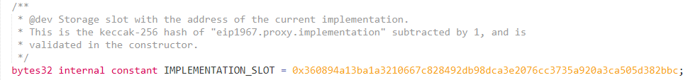
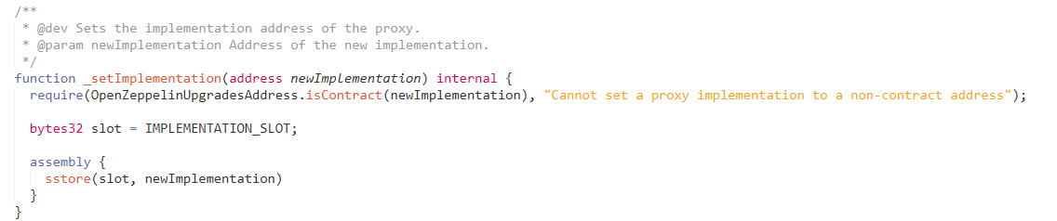
Proxy basics
Using storage of Proxy contract
Using logic of implementation contract via delegatecall
Store Proxy variables using EIP-1967: Standard Proxy Storage Slots

Slide 3
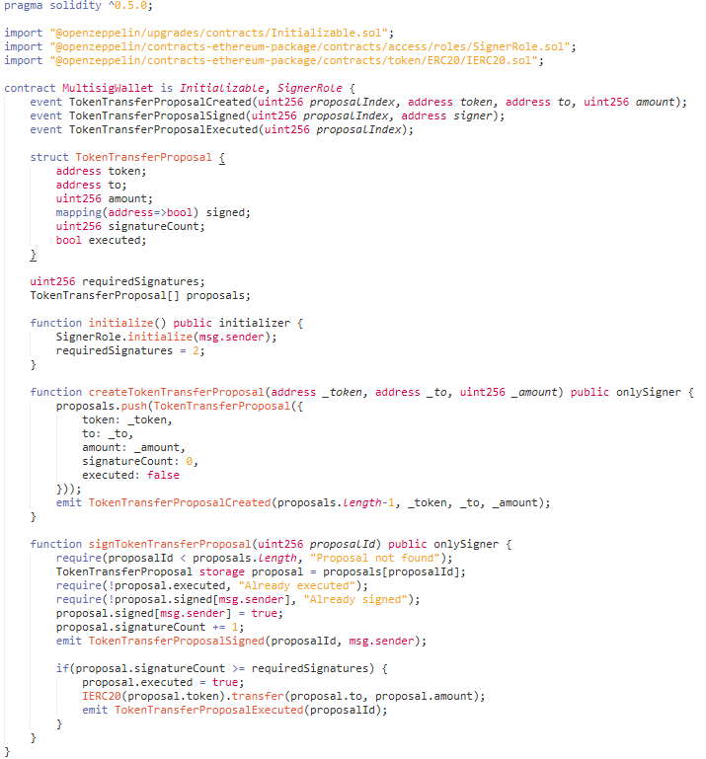
Sample contract
is Initializable
use initialize() instead of constructor
Do not use delegatecall and selfdestruct

Slide 4
Initialize OpenZeppelin project
npx oz init

Slide 5
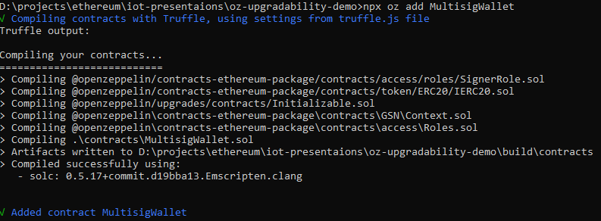
Add contracts to project
npx oz add MultisigWallet

Slide 6
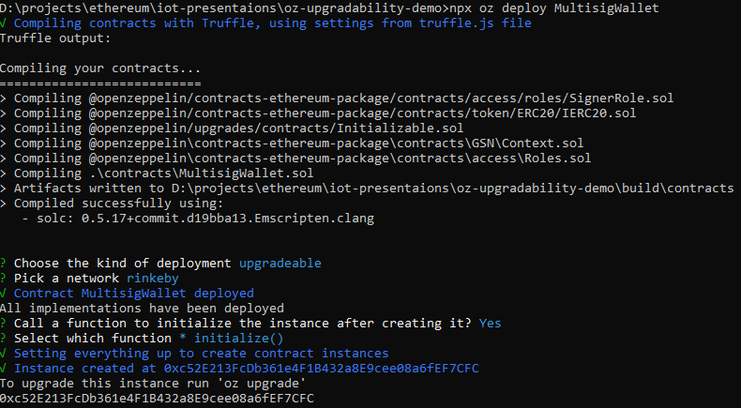
Deploy
npx oz deploy MultisigWallet

Slide 7
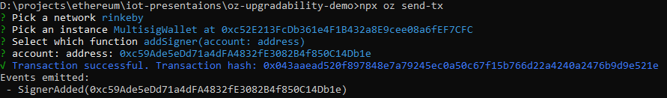
Call method
npx oz send-tx

Slide 8
Change ownership
Change Proxy admin
call npx oz set-admin %NEW_OWNER% --network mainnet
Do not forget to change owner if you used Ownable
Do not forget to change roles if you used Role model

Slide 9
Etherscan verification
https://rinkeby.etherscan.io/proxyContractChecker?a=0xc52E213FcDb361e4F1B432a8E9cee08a6fEF7CFC

